Slide 1
Empirical Research on Legal Writing

Slide 2
Today’s Goal
Review empirical research on what aspects of legal research and writing affect persuasion
Specific eye on appellate writing, but, with few studies out there, also will refer to studies of trial briefs (mostly SJ briefs)

Slide 3
Introduction, Sources, Credits
Bio
Credit to Wayne Schiess of UT law for compiling and sharing material
List of sources at end of presentation

Slide 4
Empirical Research On Legal Writing: Limits
How much is out there?
How sound are the research/ study designs? Confounding variables, survey evidence, passage of time, pre- v. post- e-reading, etc.
Does research transfer?
(non-legal→ legal;
trial→ appellate)

Slide 5
Empirical Research On Legal Writing: Limits
Differences are marginal—after the merits, and after the lawyer’s analytical skills

Slide 6
Empirical Research On Legal Writing: Limits
Takeaway: worthwhile considerations
Ammunition for drafting debates with colleagues/ clients?
Some (but not total) confirmation for legal-writing CW

Slide 7
Topics:
Readability and “Plain English”
Citation and Authority
Transitions and Connections
Intensifiers and “Emotional” Language
Priming and Storytelling

Slide 8
Readability

Slide 9
What’s “Readability”?
Plain meaning
Technical meanings: different ways of measuring

Slide 10
Readability
The Flesch Reading Ease Scale
Rudolf Flesch, How to Write Plain English 25 (1979)

Slide 11
Grade level (Flesch-Kinkaid)
Numerical score for text that corresponds to grade level:
~How many years of formal education are required for a person to understand the text?
12 = completed high school
16 = completed college
19 = completed law school

Slide 12
Does Readability Matter?
Does readability correlate with winning?
The answer is a resounding “maybe”

Slide 13
Readability Doesn’t Matter?
Study examined readability of 882 appellate briefs (state and federal) using Flesch Reading Ease scale and the Flesch-Kincaid Grade Level
Authors found no statistically significant relationship between a brief’s readability and its success
Lance N. Long & William F. Christensen, Does the Readability of Your Brief Affect Your Chance of Winning an Appeal?—An Analysis of Readability in Appellate Briefs and Its Correlation with Success on Appeal, 12 J. App. Prac. & Proc. 145 (2011).

Slide 14
Or Maybe it Does?
In another study, authors reviewed 654 summary judgment briefs, excluding cross-motions, counterclaims, and partial summary judgment
They scored briefs with 50 readability measures, including word difficulty as well as syllable, letter, and sentence counts, to generate a readability score for each brief
They also attempted to control for multiple other variables, both internal and external
Shaun B. Spencer & Adam Feldman, Words Count: The Empirical Relationship Between Brief Writing and Summary Judgment Success, 22 J. Leg. Writing Inst. 61 (2018).
Notes:
SMOG = Simple Measure of Gobbledygook
Strain = three sentences, total the syllables, divide by 10

Slide 15
Readability Matters
The authors found that a brief’s readability significantly correlated with summary judgment success.
Further, readability had a stronger relationship with winning in federal courts than in state courts
Shaun B. Spencer & Adam Feldman, Words Count: The Empirical Relationship Between Brief Writing and Summary Judgment Success, 22 J. Leg. Writing Inst. 61 (2018).

Slide 16
Shaun B. Spencer & Adam Feldman, Words Count: The Empirical Relationship Between Brief Writing and Summary Judgment Success, 22 J. Leg. Writing Inst. 61, 94 (2018).

Slide 17
Readability Matters?
Maybe it matters in trial court but not appellate court?
Maybe the 2018 study had a more sophisticated combined metric of readability than the 2011 study?

Slide 18
Checking Readability
←

Slide 19
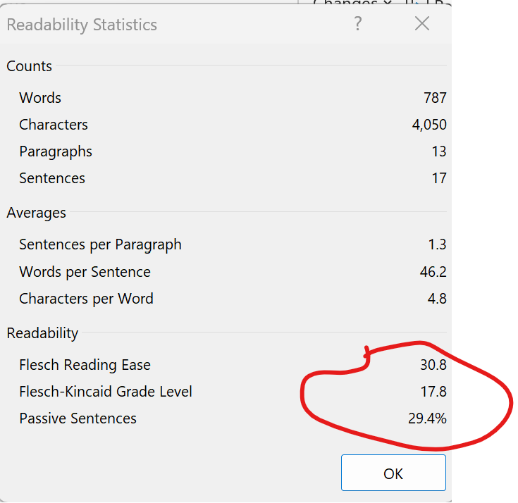
Readability Scores
AEDPA:

Slide 20
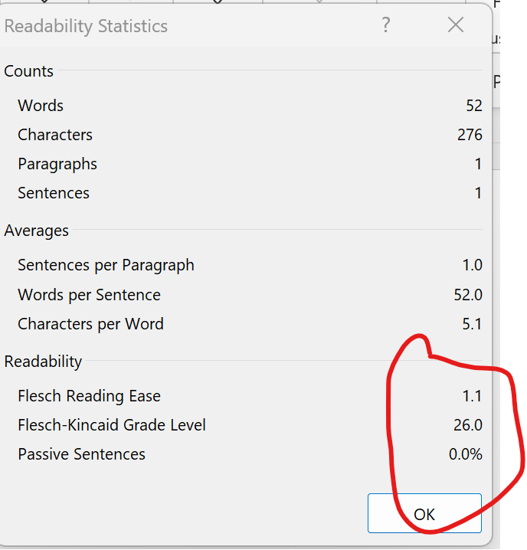
Readability Scores
????????

Slide 21
“Plain English” & Readability
“Plain English” is at least akin to “readability,” if not exactly the same thing

Slide 22
“Plain English” v. “Legalese”
“Plain English” partisans have maybe stolen a march here
Of course, “legalese” is bad; like saying “should a brief have more gibberish in it, or less?”

Slide 23
“Plain English”:
1. Use easily readable typefaces and type sizes.
2. Keep sentences and paragraphs short.
3. Use headings to create obvious, large-scale organization
4. Use moderate enumeration and tabulation for small-scale organization
5. Use concrete nouns as subjects; use concrete verbs.
6. Prefer active voice to passive.
7 . Avoid unnecessary Latin, formal words, and jargon.
8. Cut unnecessary words.
9. Punctuate correctly.
10. Test documents on the intended audience before finishing them
Wayne C. Schiess, What Plain English Really Is, 9 Scribes J. Leg. Writing 43, 72 (2003–2004).

Slide 24
“Plain English” v. “Legalese”
“Plain English” has mostly won out among appellate lawyers (I think)
But does “Plain English” actually win more?

Slide 25
“Plain English” v. “Legalese”
2010 study attempted to survey judges’ preferences for “plain English” v. “legalese” v. “informal writing”
Participants were given sample briefs in plain English, legalese, and informal language (not told which)
256 judges responded
Author tracked responses in terms of state/ federal, male/female, rural/urban
Sean Flammer, Persuading Judges: An Empirical Analysis of Writing Style, Persuasion, and the Use of Plain English, 16 Legal Writing 184 (2010).

Slide 26
“Plain English” v. “Legalese”
Judges overall preferred plain English to legalese (66%/34%)
Stronger preference (than the overall average) among federal judges (77%/23%)
Sean Flammer, Persuading Judges: An Empirical Analysis of Writing Style, Persuasion, and the Use of Plain English, 16 Legal Writing 184 (2010).

Slide 27
“Informal” v. “Legalese”
Judges overall preferred informal to legalese (58%/42%)
Female judges preferred informal to legalese (83%/17%)
Rural judges preferred legalese to informal (55%/45%)
Sean Flammer, Persuading Judges: An Empirical Analysis of Writing Style, Persuasion, and the Use of Plain English, 16 Legal Writing 184 (2010).

Slide 28
Readability/ “Plain English” v. “Legalese”
Trend evidence: Empirical studies of trends in readability (without trying to tie to win rates) have mixed results
Supreme court briefs: 2010 study (of briefs from 1970-2004) found facts and summary of argument becoming more readable; argument less
More drift away from legalese, past Plain English, and towards informality in 2023?
Brady Coleman & Quy Phung, The Language of Supreme Court Briefs: A Large-Scale Quantitative Investigation, 11 J. App. Prac. & Process 75 (2010).

Slide 29
Sentence Length
One aspect of readability, isolated
Conventional wisdom would be that shorter sentences are better and easier to comprehend
[Side note: could reading ease be a downside if merits are weak? No studies on deliberate opacity as a weak-case strategy.]

Slide 30
Study: Does Lawyering Matter?
2022 Texas Law Review essay studied several different LRW topics seeking correlations with win chances
Used machine-learning & textual-analysis methods
Attempted inter alia to test some legal-writing conventional wisdom
Elizabeth C. Tippett et al., Does Lawyering Matter? Predicting Judicial Decisions from Legal Briefs, and What That Means for Access to Justice, 100 Texas L. Rev. 1157 (2022).

Slide 31
Study: Does Lawyering Matter?
Authors gathered database of summary-judgment motions and responses in 444 employment-law cases in federal court.
Excluded briefs when motion was granted only in part.
Applied various statistical/ data analysis methods to see what characteristics did or didn’t correlate with winning
Also examined controls (court, type of suit, pro se status)—none affected the validity of the results
Elizabeth C. Tippett et al., Does Lawyering Matter? Predicting Judicial Decisions from Legal Briefs, and What That Means for Access to Justice, 100 Texas L. Rev. 1157 (2022).

Slide 32
Writing and Research Matter
One big conclusion was—yes, research & writing matters
Study found various degrees of correlation for particular differences, from zero to fairly strong
Will mention several of these
Elizabeth C. Tippett et al., Does Lawyering Matter? Predicting Judicial Decisions from Legal Briefs, and What That Means for Access to Justice, 100 Texas L. Rev. 1157 (2022).

Slide 33
Sentence Length
Conventional writing wisdom suggests shorter sentences are better
Tippett article found no correlation between sentence length and winning (.000)
Elizabeth C. Tippett et al., Does Lawyering Matter? Predicting Judicial Decisions from Legal Briefs, and What That Means for Access to Justice, 100 Texas L. Rev. 1157 (2022).

Slide 34
Authority & Citation

Slide 35
Does Lawyering Matter? Citations Do.
The Does Lawyering Matter? article found that:
“. . . . [T]he strongest results involved the citations themselves, suggesting that legal research plays a central role in brief writing. . .”
Elizabeth C. Tippett et al., Does Lawyering Matter? Predicting Judicial Decisions from Legal Briefs, and What That Means for Access to Justice, 100 Texas L. Rev. 1157 (2022).

Slide 36
How Does Citation Matter?
String cites were correlated with winning (.044)
More generally, overall citation frequency was also correlated with winning
But lengthy string cites (>5 cites) were negatively correlated
“The results generally support the advice from LRW scholars to convey the weight of the legal authority through comprehensive citations but to avoid lengthy string cites.”
Elizabeth C. Tippett et al., Does Lawyering Matter? Predicting Judicial Decisions from Legal Briefs, and What That Means for Access to Justice, 100 Texas L. Rev. 1157 (2022).

Slide 37
Research Itself Matters Most
The TLR study found the highest correlations to winning based on which cases briefs cited
Elizabeth C. Tippett et al., Does Lawyering Matter? Predicting Judicial Decisions from Legal Briefs, and What That Means for Access to Justice, 100 Texas L. Rev. 1157 (2022).

Slide 38
Research Matters: Best Cases
Certain cases that, when cited, correlated more with winning
Not, mostly, USSC cases, or, cases that are “bedrock” cases, like McDonnell Douglass (most cite those)
Tended to be circuit cases that correlated with a certain “employer-win” scenario
Elizabeth C. Tippett et al., Does Lawyering Matter? Predicting Judicial Decisions from Legal Briefs, and What That Means for Access to Justice, 100 Texas L. Rev. 1157 (2022).

Slide 39
Research Matters: Clustered Cases
Also, there were clusters of cases across briefs that correlated with winning—that is, winning briefs tended to cite (many of) the same cases (.179)
“Network” analysis and briefs that are “neighbors”
“Vectorizing citation frequency”
And, when the “best case” and “case cluster” effects were combined, it was the strongest predictor in the study
Elizabeth C. Tippett et al., Does Lawyering Matter? Predicting Judicial Decisions from Legal Briefs, and What That Means for Access to Justice, 100 Texas L. Rev. 1157 (2022).

Slide 40
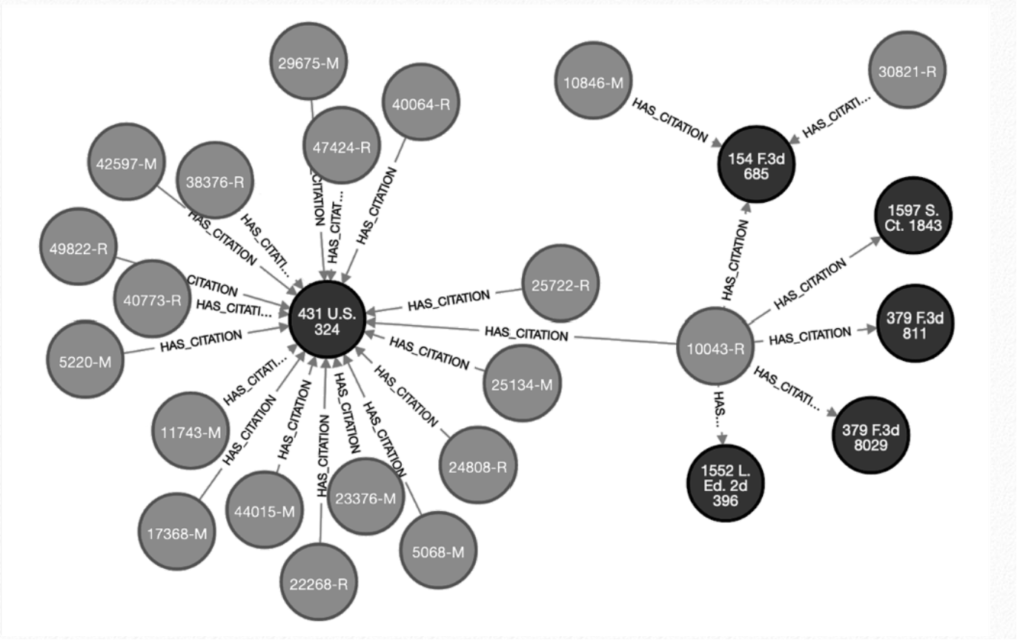
Research Itself Matters Most
Elizabeth C. Tippett et al., Does Lawyering Matter? Predicting Judicial Decisions from Legal Briefs, and What That Means for Access to Justice, 100 Texas L. Rev. 1157 (2022).

Slide 41
Case Selection: Opponent’s Cases, leading Cases
On the non-movant side, citing cases that a) your opponent also cited or b) were often cited in winning SJ briefs both tended to correlate with winning
On the other hand, citing “idiosyncratic” cases correlated with losing
Specifically, every brief that shared no citations with any other brief (“singletons”) was a losing brief
“These results suggest . . . that it is a poor strategy to exclusively cite unusual precedent in a brief, while those that cite to a common body of law tend to fare better.”
Elizabeth C. Tippett et al., Does Lawyering Matter? Predicting Judicial Decisions from Legal Briefs, and What That Means for Access to Justice, 100 Texas L. Rev. 1157 (2022).

Slide 42
How to Find the “Leading” Cases?
Expertise? Resources?
The TLR authors argued that the differences in citation could be attributed to resource disparities (e.g., plaintiff-defendant)
This seems plausible, but the article didn’t show or try to show it empirically (e.g., that briefs with better cites had richer clients or cost more)
Their proposed solution was a data-driven cite-recommendation tool based on a corpus of briefs in similar cases
Elizabeth C. Tippett et al., Does Lawyering Matter? Predicting Judicial Decisions from Legal Briefs, and What That Means for Access to Justice, 100 Texas L. Rev. 1157 (2022).

Slide 43
More on Use of authority
Another study categorized and counted the main ways judges and lawyers used case law.
The author used a database of parties’ briefs and the judicial opinions written in response—199 documents total
Brian Larson, Precedent as Rational Persuasion, 25 Legal Writing: Journal of the Legal Writing Institute 135 (2021)

Slide 44
Use of authority: Types & frequency
The study identified 5 main ways legal writers use cases (most to least frequent):
As support for a legal rule
As the source of a quotation
As an example for comparison or distinction
As support for a policy—the “why” of a legal rule
As support for a generalization about how courts decide these kinds of cases
Brian Larson, Precedent as Rational Persuasion, 25 Legal Writing: Journal of the Legal Writing Institute 135 (2021)

Slide 45
Use of authority: Winning & Losing Uses
Winning briefs tended to make more of these types of uses than losing briefs:
Policy the (“why”)
Generalization (how courts decide these kinds of cases)
Losing briefs tended to use more of these types than winning briefs:
Rule
Quotation
Example
)
Brian Larson, Precedent as Rational Persuasion, 25 Legal Writing: Journal of the Legal Writing Institute 135 (2021)

Slide 46
Transitions & Connections

Slide 47
Transitions and Connections
Using linking words, sign-posting, etc.
Research shows that transitions/ connection words can improve reader understanding

Slide 48
Transitions and Connections
E.g., two sentences linked with “because” resulted in faster comprehension than to sentences with no link
And, between sentences linked with a) nothing, b) “and,” and c) “because,” the “because” sentences were easiest to recall
Because of the connection (presumably)
Diana J. Simon, The Power of Connectivity: The Science and Art of Transitions, 18 Leg. Comm. & Rhetoric: JALWD 65 (2021)

Slide 49
“Hedging”
Hedging is a particular sort of connection that acknowledges a concern, problem, or counter
E.g., , “however,” “albeit,” “regardless,” “even if/ assuming/ though,” “nevertheless,” “while”

Slide 50
“Hedging”
The Does Lawyering Matter? study found that, among writing/ textual features, hedging had the overall highest correlation with win prediction (.061)
Hedging generally appeared when brief was acknowledging and defusing unhelpful authority or argument
Perhaps fits with idea that briefs do better if they cite, rather than ignore, opponent’s cases
Elizabeth C. Tippett et al, Does Lawyering Matter? Predicting Judicial Decisions from Legal Briefs, and What That Means for Access to Justice, 100 Texas L. Rev. 1157 (2022).

Slide 51
Intensifers & Emotional Language

Slide 52
Intensifiers
Intensifiers heighten, emphasize, or express certainty
LRW scholar (Beazley) has distinguished between “Positive” and “Negative” intensifiers
The distinction between “positive” and “negative” is based on how persuasive these are (supposed to be) to readers
Positive= more precise, followed by concrete “why”
Negative= more hyperbolic, rhetorical, overstated
E.g., “Unsubstantiated” is “positive” but “Clearly” is “negative”
Mary Beth Beazley, A Practical Guide to Appellate Advocacy 164 (2002).

Slide 53
Intensifiers–Negative v. Positive
Negative Intensifiers—abandon, absolute, absurd, artificial, axiomatic, baseless, blatant, boldly, bootstrap, clear, complete absence, completely, conclusively, cover up, cover-up, critically, defective, disingenuous, egregious, epitome, fabricated, false, flimsy, frivolous, futile, futility, illogical, impossible, improper, impugn, inflate, invalid, lack merit, let alone, manifest, mere, mystery, no effort, obvious, patently, plainly, salvage, sandbag, simply, speculative, stark, totally, transparent, unfounded, unquestionably, vain, whatsoever, without question, woefully
Positive Intensifiers—conclusory, critical, erratic, erroneous, even, excuse, fatal flaw, faulty, hastily, inadequate, inconsistencies, indisputably, irrelevant, littered, misplaced, misrepresentation, never, obfuscate, only, overwhelming, remotely, shred, unacceptably, uncorroborated, unmistakable, unsubstantiated, unsupported
Elizabeth C. Tippett et al., Does Lawyering Matter? Predicting Judicial Decisions from Legal Briefs, and What That Means for Access to Justice, 100 Texas L. Rev. 1157 (2022).

Slide 54
Do Intensifiers Matter?
The Does Lawyering Matter? study found “positive” intensifiers correlated with winning (.056)
But so did “negative” intensifiers (.055)
And the different in effects wasn’t much
So, just be intense (?)
Elizabeth C. Tippett et al., Does Lawyering Matter? Predicting Judicial Decisions from Legal Briefs, and What That Means for Access to Justice, 100 Texas L. Rev. 1157 (2022).

Slide 55
Positive Intensifiers Signal “Higher Quality”?
Authors did find, in their qualitative review of the briefs, that positive intensifiers tended to be associated with higher quality briefs
Negative intensifiers tended to be associated with lower quality briefs—poorly written, and often used in personal attacks
Elizabeth C. Tippett et al., Does Lawyering Matter? Predicting Judicial Decisions from Legal Briefs, and What That Means for Access to Justice, 100 Texas L. Rev. 1157 (2022).

Slide 56
More Evidence to Avoid “negative” intensifiers
An older study looked at intensifiers in appellate briefs from a randomly selected set of federal and state cases
Focused just on a small set of negative intensifiers: very, obviously, clearly, patently, absolutely, really, plainly, undoubtedly, totally, simply, and wholly
(Wouldn’t capture what other article called “positive” intensifiers or even all of the “negative” intensifiers)
Lance N. Long & William F. Christensen, Clearly, Using Intensifiers Is Very Bad—Or Is It? 45 Idaho L. Rev. 171, 180 (2008).

Slide 57
More Evidence to Avoid “negative” intensifiers
Found, in general, that more of these intensifiers correlated with more losing (for appellants; was neutral for appellees)
But more intensifiers correlated with more winning when the judge who wrote the opinion made heavy use of intensifiers
(Maybe: use them when they’re really warranted?)
Also: dissents tended to use these intensifiers much more than majority opinions
Lance N. Long & William F. Christensen, Clearly, Using Intensifiers Is Very Bad—Or Is It? 45 Idaho L. Rev. 171, 180 (2008).

Slide 58
Emotional Language

Slide 59
Emotional language
LRW expert wisdom is mostly against using “emotional” language and appeals to sympathy
Especially in appellate briefs

Slide 60
Sweet Emotion?
One study used automated textual analysis to track “emotional language” in U.S. Supreme Court briefs
Authors studied correlations between emotional language and justices’ votes in 1500+ cases decided during the 1984-2007 terms
Attempted to eliminate various confounds (e.g., use of authority, ideology, quality of lawyers); checked several ways for robustness
Ryan C. Black et al., The Role of Emotional Language in Briefs before the U.S. Supreme Court, J. of Law and Courts 377, 384 (Fall 2016).

Slide 61
Under-EmotE
Findings—“Justices are more likely to vote for parties whose briefs eschew emotionally charged language”
For petitioners, minimizing use of minimal emotional language is associated with a 29% increase in their probability of capturing a justice’s vote
For respondents, the effect is even greater; minimizing use of emotional language is associated with a 100% increase in their probability of winning a justice’s vote
Authors suggested that emotional language could signal to the justices lack of credibility or just overall lower-quality lawyering
Ryan C. Black et al., The Role of Emotional Language in Briefs before the U.S. Supreme Court, J. of Law and Courts 377, 384 (Fall 2016).

Slide 62
Caveats?
The authors tracked “emotional language” using a 900+ word list of emotional words, but some of those are quite common in legal writing for other readings
E.g., “abuse”→ “abuse of discretion”
The Supreme Court could be unusually/ especially resistant to emotional appeals (?)
Ryan C. Black et al., The Role of Emotional Language in Briefs before the U.S. Supreme Court, J. of Law and Courts 377, 384 (Fall 2016).

Slide 63
More On Emotion
Does Lawyering Matter? also examined whether emotional language correlated with winning, and found it did not (.000)
Elizabeth C. Tippett et al., Does Lawyering Matter? Predicting Judicial Decisions from Legal Briefs, and What That Means for Access to Justice, 100 Texas L. Rev. 1157 (2022).

Slide 64
Priming

Slide 65
Priming
Priming= preparing the reader to agree with the substance of your arguments
Introducing themes that favor your side
Setting frames via narratives or positive/ negative characterizations
“We’re relying on well-settled law, they’re asking for something unprecedented”

Slide 66
Priming
One study investigated whether priming mattered by testing whether changing the preliminary statement in a summary-judgment motion affected outcomes
163 U.S. judges read an excerpt from a brief on a cross-motion for summary judgment between a small business and a federal agency.
Kenneth D. Chestek, Fear and Loathing in Persuasive Writing: An Empirical Study of the Effects of the Negativity Bias, 14 Legal Comm. & Rhetoric 1 (2017).

Slide 67
Priming Study
Each brief had the same statement of facts and summary of the law, but the briefs had nine different versions of the preliminary statement:
four negative-themed
four positive-themed
one neutral
The only thing different was the preliminary statement; so, presumably, that was responsible for differences in outcomes
Kenneth D. Chestek, Fear and Loathing in Persuasive Writing: An Empirical Study of the Effects of the Negativity Bias, 14 Legal Comm. & Rhetoric 1 (2017).

Slide 68
Priming Worked
Judges who read preliminary statements favoring the small business viewed the case more favorably to the small business compared to those who read a neutral preliminary statement.
Judges who read a preliminary statement favoring the federal agency “were mixed but were uniformly less favorable to the small business.”
Kenneth D. Chestek, Fear and Loathing in Persuasive Writing: An Empirical Study of the Effects of the Negativity Bias, 14 Legal Comm. & Rhetoric 1 (2017).

Slide 69
StoryTelling

Slide 70
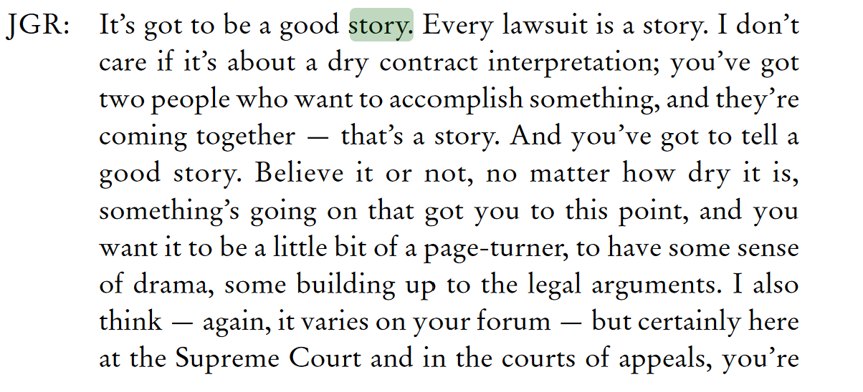
Narrative/Storytelling
Conventional LRW wisdom strongly encourages telling a story in legal writing (including appellate briefwriting)
Chief Justice John Roberts, Interview with Bryan Garner, 13 Scribes Journal of Legal Writing 5, 16 (2010)

Slide 71
Narrative/Storytelling
Does storytelling actually increase persuasion?
One researcher studied this with an A/B test to see if including a narrative element made a difference
Kenneth Chestek, Judging by the Numbers: An Empirical Study of the Power of Story, 7 J. Assn. Legal Writing Directors 1, 19 (Fall 2010)

Slide 72
Controlling the Narrative
Author sent briefs for a fictional case to 95 readers (including judges, clerks, staff attorneys, practitioners, & law professors)
Each reviewer got two briefs:
one with a narrative component—(facts tell a story, brief weaves in a theme)—plus legal argument
one with no narrative component—advocating for the same party but with only legal arguments
The author controlled for possible reader preferences for Petitioners and Respondents.
Kenneth Chestek, Judging by the Numbers: An Empirical Study of the Power of Story, 7 J. Assn. Legal Writing Directors 1, 19 (Fall 2010)

Slide 73
Stories Do Matter
The majority, 64%, found the narrative briefs more persuasive.
Kenneth Chestek, Judging by the Numbers: An Empirical Study of the Power of Story, 7 J. Assn. Legal Writing Directors 1, 19 (Fall 2010)

Slide 74
To Some People. . .
Practitioners, staff attorneys, and law professors were the most persuaded by story briefs.
Appellate judges preferred the story briefs by a slim majority
Law clerks basically had no preference for the story
More generally, time in practice mattered: those with 15+ years experience had a much stronger preference for story than those with <9 years
Gender of reader did not make a difference
Kenneth Chestek, Judging by the Numbers: An Empirical Study of the Power of Story, 7 J. Assn. Legal Writing Directors 1, 19 (Fall 2010)

Slide 75
To Some People. . .
Notably, practicing lawyers were much more persuaded by story than appellate judges or law clerks
Petitioners preferred story 70/30, but appellate judges only preferred by a slim majority & law clerks had no preference
So, maybe story is overrated by practitioners?
Caveat: small sample size in survey
Kenneth Chestek, Judging by the Numbers: An Empirical Study of the Power of Story, 7 J. Assn. Legal Writing Directors 1, 19 (Fall 2010)

Slide 76
Sources
Ryan C. Black, Matthew E.K. Hall, Ryan J. Owens, & Eve M. Ringsmuth, The Role of Emotional Language in Briefs before the U.S. Supreme Court, J. of Law and Courts 377, 384 (Fall 2016).
Kenneth D. Chestek, Fear and Loathing in Persuasive Writing: An Empirical Study of the Effects of the Negativity Bias, 14 Legal Comm. & Rhetoric 1 (2017).
Kenneth Chestek, Judging by the Numbers: An Empirical Study of the Power of Story, 7 J. Assn. Legal Writing Directors 1, 19 (Fall 2010).
Brady Coleman & Quy Phung, The Language of Supreme Court Briefs: A Large-Scale Quantitative Investigation, 11 J. App. Prac. & Process 75 (2010).
Sean Flammer, Persuading Judges: An Empirical Analysis of Writing Style, Persuasion, and the Use of Plain English, 16 Legal Writing 184 (2010).
Brian Larson, Precedent as Rational Persuasion, 25 Legal Writing: Journal of the Legal Writing Institute 135 (2021).
Lance N. Long & William F. Christensen, Clearly, Using Intensifiers Is Very Bad—Or Is It? 45 Idaho L. Rev. 171, 180 (2008).
Lance N. Long & William F. Christensen, Does the Readability of Your Brief Affect Your Chance of Winning an Appeal?—An Analysis of Readability in Appellate Briefs and Its Correlation with Success on Appeal, 12 J. App. Prac. & Proc. 145 (2011).
Chief Justice John Roberts, Interview with Bryan Garner, 13 Scribes Journal of Legal Writing 5, 16 (2010)
Wayne C. Schiess, What Plain English Really Is, 9 Scribes J. Leg. Writing 43, 72 (2003–2004).
Shaun B. Spencer & Adam Feldman, Words Count: The Empirical Relationship Between Brief Writing and Summary Judgment Success, 22 J. Leg. Writing Inst. 61 (2018).
Diana J. Simon, The Power of Connectivity: The Science and Art of Transitions, 18 Leg. Comm. & Rhetoric: JALWD 65 (2021).
Elizabeth C. Tippett, Charlotte S. Alexander, Karl Branting, Paul Morawski, Carlos Balhana, Craig Pfeifer and Sam Bayer, Does Lawyering Matter? Predicting Judicial Decisions from Legal Briefs, and What That Means for Access to Justice, 100 Texas L. Rev. 1157 (2022).

