Slide 1
CIVIL LAW UPDATE 2023

Slide 2
Civil Law Update - Panelists
Michael J. Bentley, Bradley (Jackson, Miss.)
Allison A. Jones – Downer, Jones, Marino & Wilhite (Shreveport, LA.)
Martin A. Stern, Adams and Reese (New Orleans, LA.)

Slide 3
EN BANC OPINION

Slide 4
Hamilton v. Dallas Cnty., No. 21- 10133, F.4th , 2023 U.S. App. LEXIS 21780, 2023 WL 5316716 at *1 (5th Cir. Aug. 18, 2023) (AAJ)
TEXTUALISM V.
“ULTIMATE EMPLOYMENT DECISION”

Slide 5
PANEL OPINONS CASES OF INTEREST

Slide 6
Carmouche v. Hooper, 77 F.4th 362, 2023 U.S. App. LEXIS 20891 (MB)
Case Details
Panel: Weiner, Graves, Douglas
Written by: Douglas

Slide 7
BRAIDWOOD MGMT. V EEOC, 70 F.4th 914 (5th Cir. 2023) (MS)
Case Details
Panel: Smith, Clement, Wilson
Written by: Smith
This Photo by Unknown Author is licensed under CC BY-SA-NC

Slide 8
JANUARY V. CITY OF HUNTSVILLE, 74 F.4TH 646 (5TH CIR. 2023) (AAJ)
Case Details
Panel: Jones, Clement and Haynes
Written by: Clement
PRETEXT

Slide 9
Missouri v. Biden, 2023 U.S. App. LEXIS 23965, __ F.4th __, 2023 WL 5821788 (MS)
Case Details
Panel: Clement, Elrod and Willett
Per Curiam
This Photo by Unknown Author is licensed under CC BY-NC-ND

Slide 10
United States ex rel. Aldridge v. Corp. Mgmt., 2023 U.S. App. LEXIS 21926, 78 F.4th 727 (MB)
Case Details
Panel: Jones, Ho and Wilson
Written by: Wilson

Slide 11
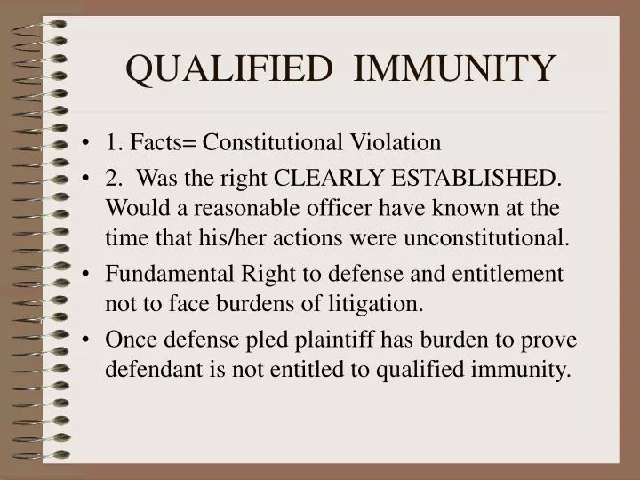
Hicks v. LeBlanc, 2023 U.S. App. LEXIS 23556, __ F.4th __, 2023 WL 5694871 (MS)
Case Details
Panel: Higginbotham, Southwick, Willett
Written by: Higginbotham

Slide 12
Civil Law Update
Q&A

